Slide 1
Publishing and subscribing
ROS tutorial #2

Slide 2
ROS computation graph
Topic 1
/odom
Topic 2
/cmd_vel
Node 1
Node 2
Node 3
x: 0.1
y: -1
z: 0
Forward: 0.2
Turn: 0
Wheel odometer
Path planner
Motor controller

Slide 3
Publishing and subscribing
Any node can publish a message to any topic
Any node can subscribe to any topic
Multiple nodes can publish to the same topic
Multiple nodes can subscribe to the same topic
A node can publish to multiple topics
A node can subscribe to multiple topics

Slide 4
Publish/subscribe tools
rosnode list
rosnode info /some_node
rostopic list
rostopic info /some_topic
rostopic echo /some_topic
rostopic pub /some_topic msg/MessageType "data: value"

Slide 5
Messages
A serialization format for structured data
Allows nodes written in C++ and Python to communicate with each other
Defined in a .msg file
Must be compiled into C++ / Python classes before using them

Slide 6
What is the ROS master?
A server that tracks the network addresses of all other nodes
Also tracks other information like parameters
Informs subscribers about nodes publishing on the same topic
Publisher and subscriber establish a peer-to-peer connection
Nodes must know network address of master on startup (ROS_MASTER_URI)
Can be started with roscore or roslaunch
Master
Subscribing to /topic
Publishing /topic on localhost:1234
localhost:1234 is publishing /topic
Publisher
Subscriber
Message data for /topic

Slide 7
Let's write some code!

Slide 8
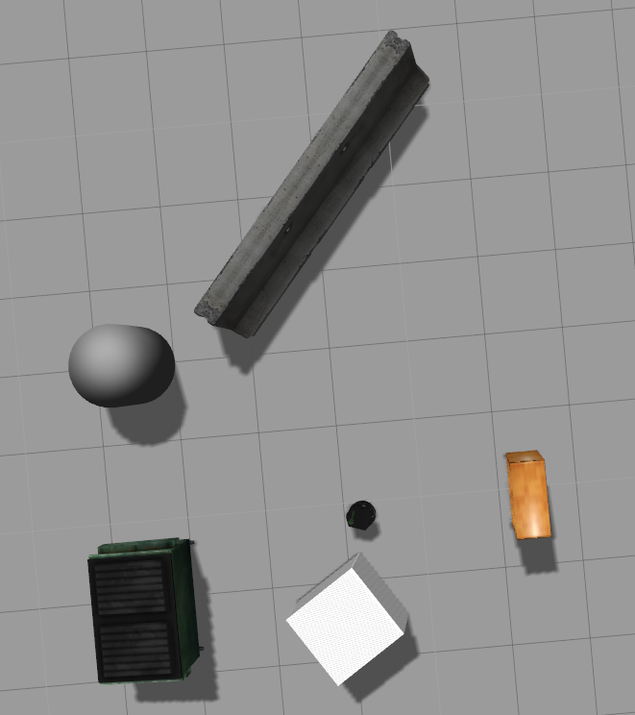
Are we there yet?
Robot publishes the name and distance to the closest landmark
Make the robot print out "I'm near the {landmark}" when it enters one of the circled zones
E.g., "I'm near the cube"
Zones are circles with 1 meter diameter
Barrier
Cylinder
Bookshelf
Dumpster
Cube

Slide 9
Next video
Creating a catkin workspace
Creating a new package
Creating a message
Collecting landmark locations
Implementing the landmark monitor

